Slide 1
2017 USENIX
Loophole: Timing Attacks on Shared Event Loops in Chrome
Authors: Pepe Vila and Boris Köpf
Institution: IMDEA Software Institute, Technical University of Madrid (UPM) 马德里工业大学IMDEA软件学院

Slide 2
Introduction

Slide 3
Introduction
In this paper we demonstrate that shared event loops are vulnerable to side-channel attacks, where a spy process monitors the loop usage pattern of other processes by enqueueing events and measuring the time it takes for them to be dispatched.
Specifically, attacks against the two central event loops in Google’s Chrome web browser：the I/O thread of the host process, which multiplexes all network events and user actions, and the main thread of the renderer, which processes handles rendering and Javascript tasks.
Event Loop机制说明1，Event Loop 机制说明2

Slide 4
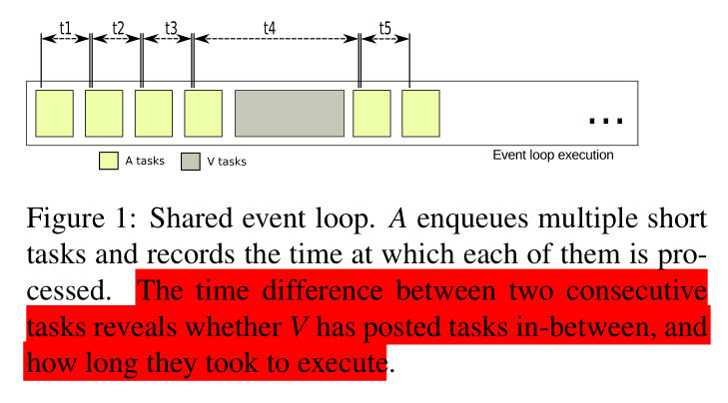
Introduction
A：攻击程序 V：受害程序
The key observation is that event loops form a resource that can be shared between mutually distrusting programs. Hence, contention of this resource by one program can be observed by the others through variations in the time the control process takes for dispatching their events.

Slide 5
Introduction
Attack Objects
The host process, whose event loop is shared between all requests for common resources, such as network and user interface; and the renderer processes, whose loops can be shared between Javascript tasks of different tabs or iframes.
Base technologies
1. postMessage API -> renderer process，用于跨源通信
2. network requests to nonroutable IP addresses and SharedWorkers -> host process

Slide 6
Introduction
Three demonstration
1. We show how event delays during the loading phase, corresponding to resource requests, parsing, rendering and Javascript execution, can be used to uniquely identify a web page.
2. We illustrate how user actions in cross-origin pages can be detected based on the delays they introduce in the event loop.
3. We demonstrate that shared event loops can be used to transmit information between cross-origin pages.
Contribution
Our attacks show that event loops can be successfully spied on even with simple means. They work under the assumption that event loops behave as FIFO queues.

Slide 7
Isolation Policies and
Sharing of Event Loops in Chrome

Slide 8
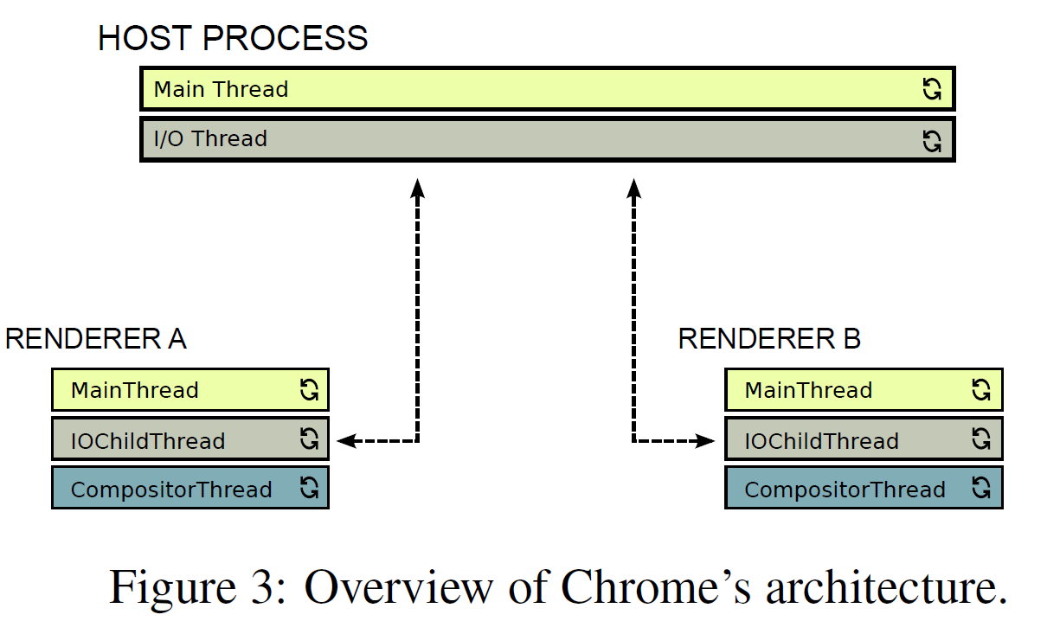
Isolation Policies and Sharing of Event Loops in Chrome
Same Origin Policy—同源策略
三个相同：协议相同，域名相同，端口相同（不指定端口默认是80端口）
Overview of the Chrome Architecture
The host process runs the top-level browser window. It has access to system resources such as network, file system, UI events, etc.
1. Main thread, which handles, e.g., user interaction events.
2. IO Thread, which handles, e.g., IPC, network stack, and file system.

Slide 9
Isolation Policies and Sharing of Event Loops in Chrome
Same Origin Policy—同源策略
三个相同：协议相同，域名相同，端口相同（不指定端口默认是80端口）
Overview of the Chrome Architecture
The renderer processes are sandboxed processes responsible for parsing, rendering and Javascript execution.
1. the MainThread where resource parsing, style calculation, layout, painting and non-worker Javascript runs.
2. IO ChildThread, which handles IPC communication with the host process.
3. the CompositorThread, which improves responsiveness during the rendering phase by allowing the user to scroll and see animations while the main thread is busy, thanks to a snapshot of the page’s state.

Slide 10
Isolation(隔离) Policies and Sharing of Event Loops in Chrome
Sharing in the Renderer Processes
1. several pages/instances/script-connected tabs share the some renderer process
2. host and renderer share the same OS process.
Sharing in the Host Process
1. renderers have to communicate with the host process for network requests or user input. The corresponding messages of all renderers pass through the event loop of the host process’ I/O thread.

Slide 11
Eavesdropping on Event Loops in Chrome

Slide 12
Eavesdropping on Event Loops in Chrome-攻击原理/技术
The Renderer Process Event Loop
1. Threat Scenarios
Malicious advertisement: A runs as an advertisement iframed in V.
Keylogger: A pops up a login form to authenticate its users via V’s Oauth
2. Monitoring Techniques
To increase the resolution, we instead use the postMessage API for sending asynchronous messages to ourselves.
3. Interferences
Just-in-time compilation (JIT): trigger code optimization or deoptimization.
Solve: warm-up phase of about 150 ms to obtain fully optimized code.
Garbage collection (GC): scavenges are easily identifiable due to their periodicity, while major collections could be spotted due to their characteristic size.

Slide 13
Eavesdropping on Event Loops in Chrome
The Host Process Event Loop
1. Threat Scenarios
Covert channel: Pages of different origins running in different (disconnected) tabs can use the shared event loop to implement a covert channel, violating the browser’s isolation mechanisms.
Fingerprinting: A tab running a rogue page of A can identify which pages are being visited by the user in other tabs by spying on the shared event loop.
2. Monitoring Techniques
The first technique is to use network requests to systematically monitor the event loop
of the I/O thread of the host process.
The second technique relies on web workers, which is a mechanism for executing Javascript in the background.
3. Interferences
The most notable ones include the interleaving with the host’s main thread and the messages from other renderers, but also the GPU process and browser plugins.
While these interferences could potentially be exploited as side channels, the noise becomes quickly prohibitive as the loop gets crowded.

Slide 14
Eavesdropping on Event Loops in Chrome
The LoopScan Tool
1. explore the characteristics of the side channel caused by sharing event loops
side-channel: 针对加密电子设备在运行过程中的时间消耗、功率消耗或电磁辐射之类的侧信道信息泄露而对加密设备进行攻击的方法被称为边信道攻击。
2. LoopScan is based on a simple HTML page that monitors the event loops of the host and renderer processes.
3. It relies on the D3.js framework, and provides interactive visualizations with minimap, zooming, and scrolling capabilities, which facilitates the inspection(检查) of traces.
4. LoopScan source is publicly available at https://github.com/cgvwzq/loopscan

Slide 15
Attacks

Slide 16
Attacks
Chrome (ranging from v52-v58).
Page identification—根据share event loop监控数据来对页面进行识别。
1. Sample Selection:
Alexa Top 1000 sites, remove duplicates, select 500 sites
2. harvesting procedure
We automate the harvesting procedure for the renderer process (5s each page) as follows:
1. Open a new tab via target = window.open(URL, '_blank'); 2
2. Monitor the event loop until the trace buffer is full
3. Close the tab
4. Send the trace to the server
5. Wait 5 seconds and go to 1 with next URL
The harvesting procedure for the host process (9s each page) differs only in that we use the rel="noopener" attribute in order to spawn a new renderer.
Three machines-> renderer process (5s each page, 200.000 data items, all machines) + host process (9s each page, 100.000 data items, (2) and (3)) –> 500 sites
总耗时：3*(500*6)+2*(500*9)=5 hours,但是可以三台电脑并行。所以共耗时2小时左右。
event-delay traces是什么？ the delay between two subsequent measurement events on an otherwise empty loop.

Slide 17
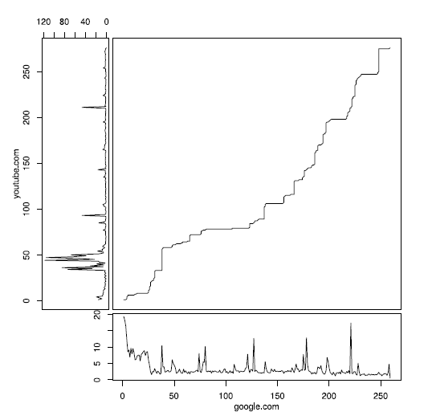
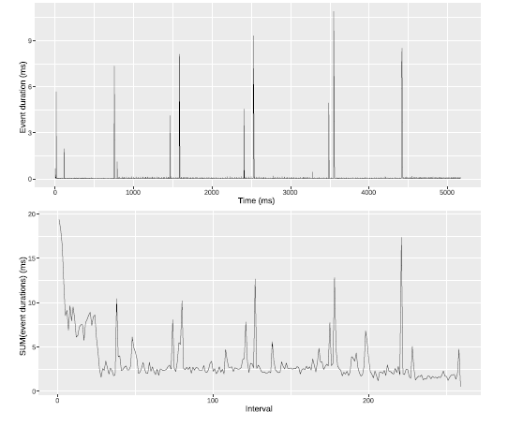
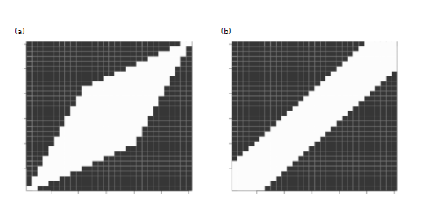
Attacks
Chrome (ranging from v52-v58).
3. 数据分类
Event Delay Histograms：聚类方法分成k类，并使用直方图表示各类数目，采用欧氏距离作为相似性度量；---识别率低于15%。
Dynamic Time Warping：保留时间信息，并在时间序列数据中进行点与点的匹配，从而计算时间序列数据的相似性；（不是太懂？）
4. Speed-up Techniques
数据层面：类似于池化的方式，缩短时间序列数据的长度；
算法层面：使用windowing(全局)和Step patterns(局部)约束。
The symmetric1 pattern favors progress close to the diagonal, the symmetric2 pattern allows for arbitrary compressions and expansions, and the asymmetric forces each point in the reference to be used only once.

Slide 18
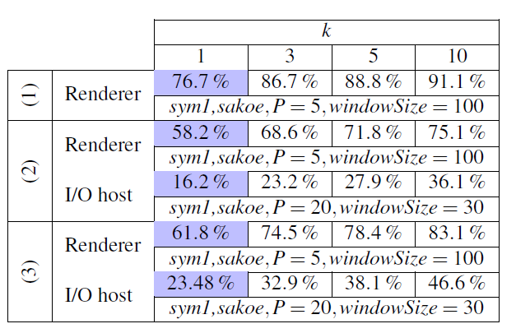
Attacks
Chrome (ranging from v52-v58).
5. Parameter tuning
a. divide our dataset of 30 traces (per page, loop, and machine) into 15 traces for tuning and 15 for cross-validation.
b. we perform a lightweight version (with 3 rounds) of the evaluation phase.
6. Experimental results
We measure performance in terms of the k-match rate, which is the percentage of pages in the testing set for which the true match is within the set of k closest matches. We abbreviate the 1-match rate by recognition rate, i.e. the percentage of pages where the best match is the correct one.
10-fold cross-validation results on different machines and different event loops, with the best configuration after tuning. Machines (1) and (2) refer to the Linux desktops, (3) to the OSX laptop, as described in Section 4.1.2.
The code and datasets used for tuning and cross validation are available as an R library at https://github.com/cgvwzq/rlang-loophole.

Slide 19
Attacks
Chrome (ranging from v52-v58).
7. Limitation
a. In real world scenarios there can be more pages concurrently running the browser, which will make detection harder.
b. our attacks do not make any use of the pages’ source code or of details of Chrome’s scheduling system with priority queues, the GC with periodic scavenges, or the frame rendering tasks.

Slide 20
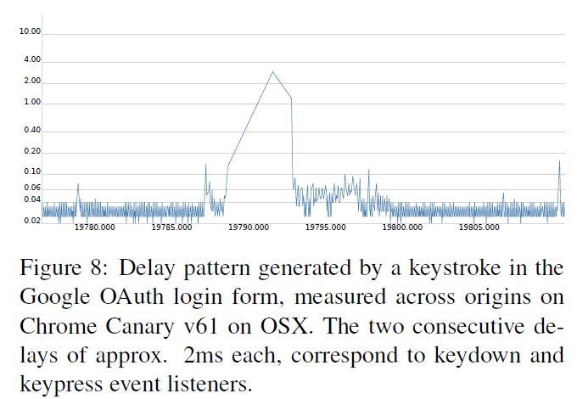
Attacks
Chrome (ranging from v52-v58).
Detecting User Behavior—用户行为检测
1. Inter-keystroke Timing Attack on Google’s OAuth login form
Oauth process
1. A web application A pops up the login form of a trusted provider T;
2. User V types their (name and) password and submits the form to T;
3. T generates an authorization token.(T生成授权令牌)
原理：Because the window of the login form shares the event loop with the opener’s renderer, a malicious A can eavesdrop on the keystroke events issued by the login form.
监听时，击键事项会有一个明显的时间延迟间隔，如下。
The trace contains two characteristic consecutive delays, caused by the keydown and keypress event listeners.
We use this observation to identify keystrokes, by scanning the event-delay trace for pairs of consecutive delays that are within a pre-defined range, forgoing any training or offline work.

Slide 21
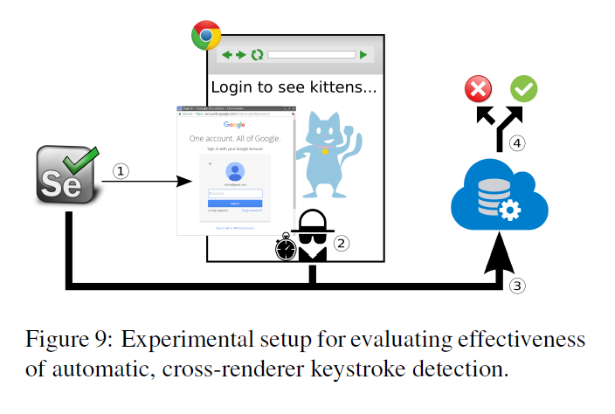
Attacks
Chrome (ranging from v52-v58).
Detecting User Behavior—用户行为检测
2. Experimental Evaluation
a. Selenium3脚本(V)模拟用户输入，点击登陆按钮并输入密码；
b. 攻击者(A)监控事件循环,获取时间延迟；
c. V和A分别提交真实击键时间(真值)和检测击键时间；
d. 比较两个击键时间，得到准确率。

Slide 22
Attacks
Chrome (ranging from v52-v58).
Detecting User Behavior—用户行为检测
3. Experimental results
a. 10.000 passwords extracted from the RockYou dataset;
b. 91:5% of the cases, our attack correctly identifies the length of a password. In 2:2% of the cases, the attack misses one or more characters, and in 6:3% of the cases it reports spurious characters.
4. Open Challenges for Recognizing User Events
Detecting User Events beyond Keystrokes. (例如：鼠标移动，有特定的频率和持续时间，容易检测；鼠标点击事件亦可以很容易被检测出来)
Detecting User Events in the Host Process. (相比于renderer process，其噪声高，用户时间所得到的信号短，使其难以检测。)

Slide 23
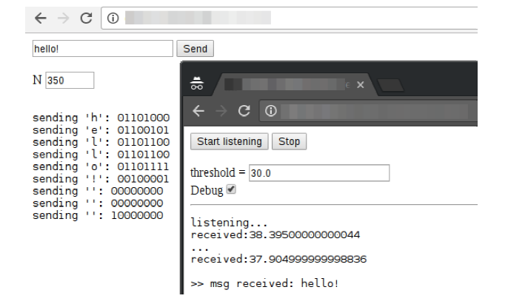
Attacks
Chrome (ranging from v52-v58).
Covert Channel-构建跨源站点的非法交流通道
1. Shared Renderer Process
原理：定义编码协议，发送者page S产生相应的特定事件,进行编码(例如：idle，为0，产生x时长的事件，为1)，接收者page R通过共享事件循环进行监听，进行解码，如此，两者达到了交流的目的。
优势：相比于其他方法，不需要两个页面建立连接通道；
2. Shared host I/O Process
原理同上，发送者和接收者换成了两个渲染器进程，这种方式相对于1更加具有威胁，攻击者可以运行在后台窗口，从而在不影响交流的情况下，和前台跨源窗口进行通信交流。

Slide 24
Discussion
1. Beyond Chrome
Despite this difference, tests with LoopScan on Firefox version 55 show that congestion on both event loops is observable across origins and tabs.
a microbenchmark with a set of 30 pages with 15 traces each.---49% recognition rate
2. Countermeasures
a. limit on the rate at which tasks can be posted into an event loop.---降低性能
b. an accumulate and serve policy, which has the advantage of limiting the amount of information leaked while retaining high amortized throughput.
c. monitor the IPC activity of all renderers and penalize or flag those who exhibit a bad or anomalous behavior.
e. limit the resolution of available clocks.---但现在有很多不依赖于时钟的计时方法。
f. use a different renderer for different origins, except for some corner cases.
g. limit how much CPU a background page is allowed to use.--- background tabs with audio activity不适用，另外Chrome v57 pages在10s后才会限制后台进程，时间过长。

Slide 25
Conclusion
In this paper we demonstrate that shared event loops in Chrome are vulnerable to side-channel attacks, where a spy process monitors the loop usage pattern of other processes by enqueueing tasks and measuring the time it takes for them to be dispatched. We systematically study how this channel can be used for different purposes, such as web page identification, user behavior detection, and covert communication.
创新点：以shared event loops作为媒介，不需要其他资源，获取事件延迟时间信息，实现侧通道攻击，从而进行页面识别，用户行为检测以及构建跨源网页隐蔽通道通信。

